Slide 1
The Castlereagh Statement
Soft launch webinar
A cross-sector call to action on Australian education and training in the age of AI​

Slide 2


Slide 3
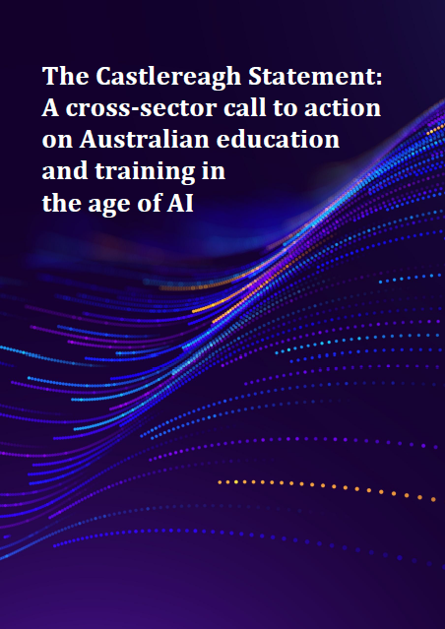
What is the Castlereagh Statement?
A unified national, cross-sector vision. A green paper, setting direction and inviting everyone to build the path together
Released April 2026, building on the 2019 Alice Springs (Mparntwe) Education Declaration
80+ contributors from 30+ organisations across schools, VET, universities, industry, government, and students

Slide 4
Why the Castlereagh Statement, now?
Many reports & research but patchwork action
Pace of AI is mismatched with processes in our education & training systems
Employer and society needs are shifting

Slide 5
The Castlereagh Statement
Three goals
Six principles
Three horizons

Slide 6

Three goals
A shared definition of what we value in human educators and learners, and aligned measurement and incentive systems to support these.
Coherent and scaffolded learning pathways from early childhood to lifelong learners, aligned with societal and workplace needs.
Every Australian being capable of confidently, critically, and creatively engaging with AI.

Slide 7

Six principles
Redefining the educated, future-ready Australian. Human qualities, discernment, and learning how to learn.
Institutional and individual humility. Be willing to transform, consolidate, or retire existing structures.
Reconceptualising learning and assessment. Shift to prioritising deep understanding, visible skill development, and the relational, human nature of learning.

Slide 8
Six principles
Designing an agile and capability-focused curriculum. Reduce duplication and overcrowding; prioritise human capability.
Empowering educators. Time, training, incentives, and recognition for educators to lead change.​
Placing technology in service of pedagogy and trust. AI deployed to serve learners with active co-design.

Slide 9
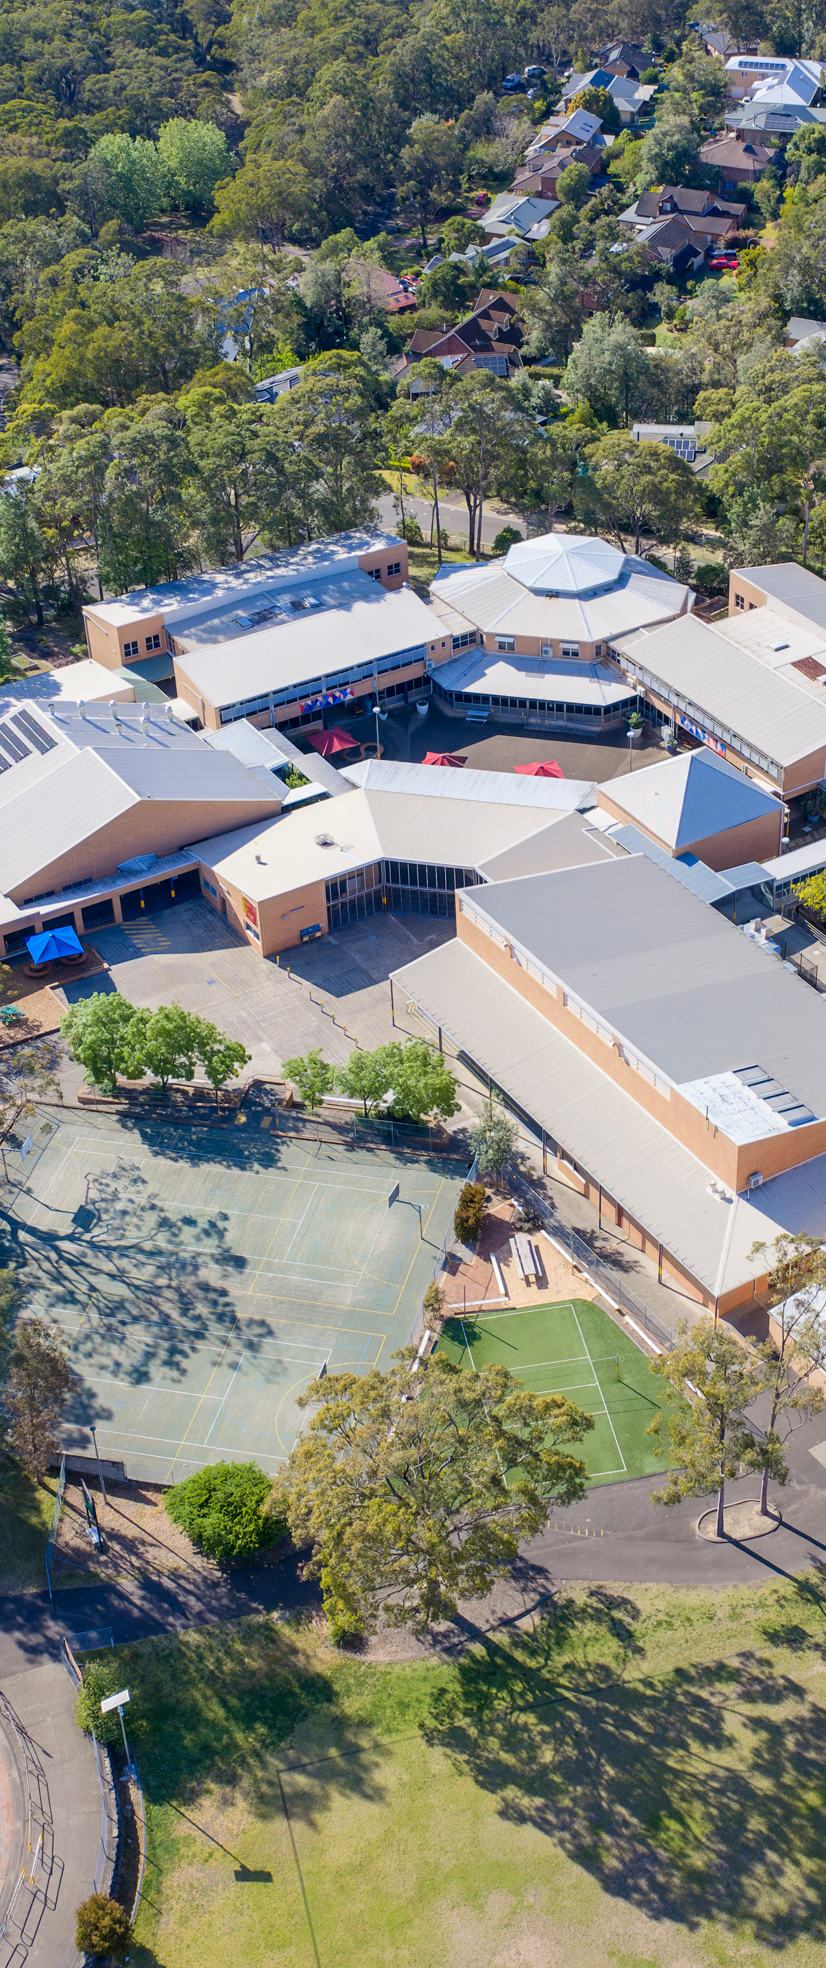
Three horizons for action
Near horizon: urgent stabilisation
  Guardrails for responsible AI use; structural assessment changes; educator capability uplift
Medium horizon: structural transitions
  Reform and realign curriculum and assessment to societal needs; shift incentive structures; networked learning lab for pilots
Far horizon: new foundations
  Reimagine education around mission-driven capability-focused learning; seamless movement across lifelong learning

Slide 10
Cross-sector perspectives

Slide 11
Next steps

Slide 12
A coalition of the willing, enabled, and empowered
300+ people across the country to date
What people are saying
  Feel siloed and want to be part of a coordinated conversation
  Assessment reform most urgent, followed by educator PD
What people want
  Amplifying the Statement to their networks
  Running and sharing pilots
  Clear pathways to contribute to nation-wide work

Slide 13
One specific thing
What is one specific thing you could do in the next 1-2 months that is aligned to the Statement?
Your commitments to Padlet: https://padlet.com/sydney/what-is-one-specific-thing-you-could-do-in-the-next-1-2-mont-bmj1be1t3kcffr74

Slide 14
We need to build the architecture together
Webinars
Action plans formulated
National summit?
May
Jun
Jul
Aug
Sep
Oct
Nov
Dec
Monthly working party meet-ups
White paper with
recommendations:
Action plans
Vignettes of practice
Student voice
Refined Statement
Notes:
The Statement is deliberately a green paper. It sets the direction; the architecture must be built together.

Slide 15
Sector-wide and cross-sector working parties
Monthly meet-ups
Formulate specific action plans
Collect and surface vignettes of practice
Make progress visible
Schools
VET
IT enablement
Curriculum and alignment
Credentialling and assessment
Government and advocacy
Higher education
Workplace

Slide 16
What should be the future of education and training?
A unified national vision for education and training from practitioners across every sector, calling for the coordination and courage to act together
castlereagh.ai
Notes:
Leaders dot know the questions to ask, so complex!
Tools stuff is dominating
What are the right questions? Value! Why are we here in the first place
Politician influencing – need leaders speaking out

Slide 17
castlereagh.ai

